Slide 1
Analysis of Locations :
Ads Target Area & Users’ location
Pengcheng Hu
2017/1/15

Slide 2
Motivations
Geographic analysis of Ads target area & users’ location
Methods to filter Ads according to locations
Improve performance of pClicks

Slide 3
Data
Data Of WoodBlock
AdId AdTitle
AdLatitude AdLongitude AdTargetRadius AdGeoTargetedLocationID
Latitude Longitude LocationCity LocationMetroArea
Impresions Clicks GoodClicks

Slide 4
Distance between two geography coordinates
Distance between two points on the surface of a spheroid
Vincenty‘s formula: Suppose the Earth is oblate spheroid
Great-circle distance: Suppose the Earth is spherical

Slide 5




Distance between two geography coordinates
Great-circle distance
$$d=\cos^{−1}\left(\sin{φ_{1}⋅\sin{φ_{2}}}+\cos{λ_{1}⋅\cos{λ_{2}}}⋅\left(λ_{1}−λ_{2}\right)\right)⋅R$$
,
,
:
$$φ﷮1$$
$$φ_{2}$$
Latitudes of two points
$$λ_{1}$$
,
$$λ_{2}$$
:
Longitude of two points
R: radius of Earth

Slide 6





Boundary of Ads target area
Find boundary given the center coordinates and radius
$${lat}_{max}=lat+r/R$$
$${lat}_{min}=lat−r/R$$
$$∆lon=\sin^{−1}\left(\sin\left(r/R\right)/\cos{(lat}\right)$$
$${lon}_{min}=lon−∆lon$$
r: radius of center to boundary
R: radius of Earth
$${lon}_{max}=lon+∆lon$$

Slide 7
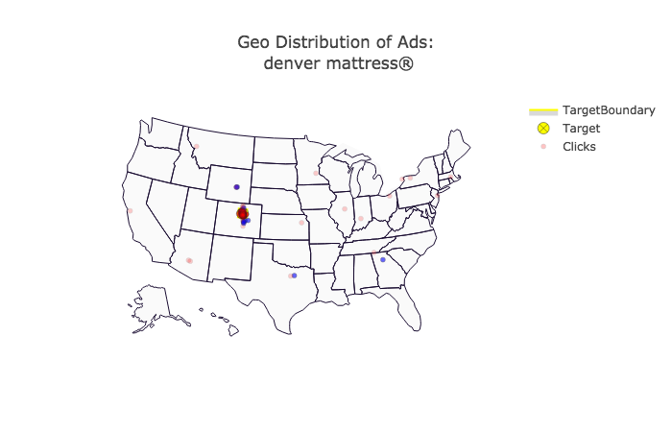
Ads 6684573884: denver mattress®
IB impressions rate: 0.934
CTR IB:0.084
GoodCTR IB:0.066
CTR OB: 0.273
GoodCTR OB: 0.273

Slide 8
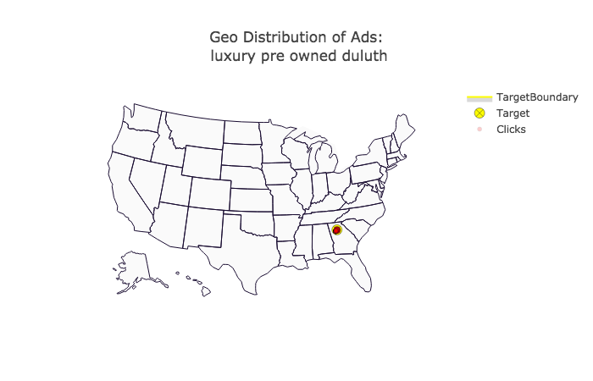
Ads 10733724030: luxury pre owned duluth
IB impressions rate: 1.000
CTR IB:0.004
GoodCTR IB:0.004
CTR OB: 0.000
GoodCTR OB: 0.000

Slide 9
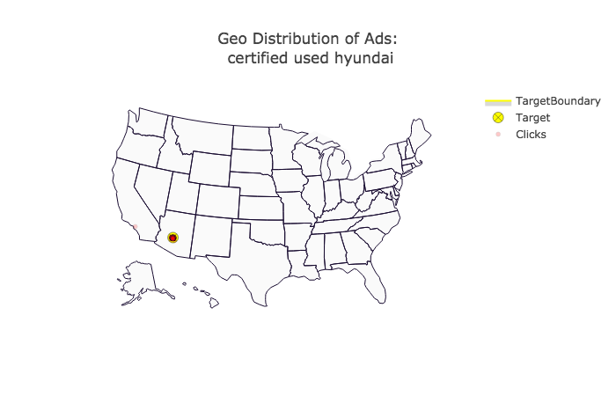
Ads 7783206080:certified used hyundai
IB impressions rate: 0.978
CTR IB:0.043
GoodCTR IB:0.025
CTR OB: 0.000
GoodCTR OB: 0.000

Slide 10
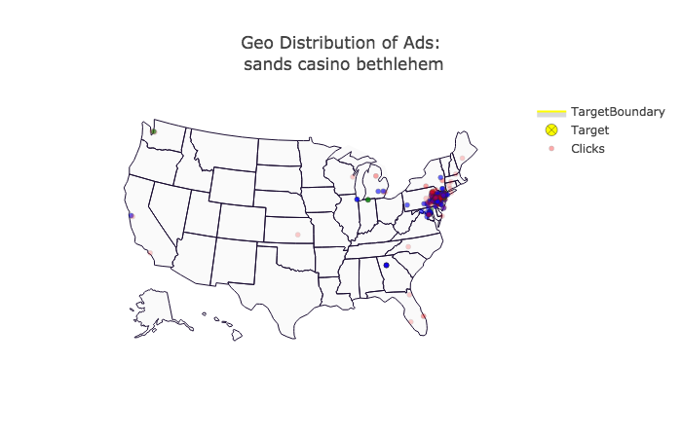
Ads 6786566351:sands casino bethlehem
IB impressions rate: 0.358
CTR IB:0.352
GoodCTR IB:0.318
CTR OB: 0.349
GoodCTR OB: 0.318

Slide 11
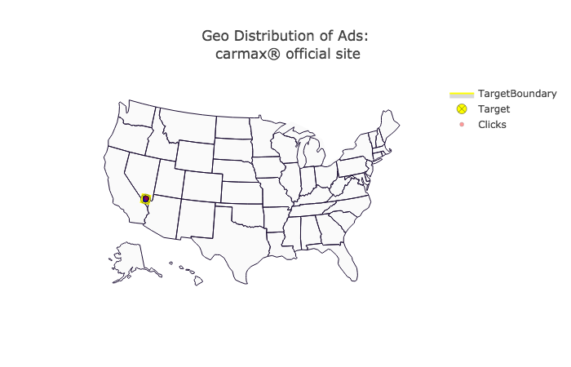
Ads 12229849367: carmax® official site
IB impressions rate: 1.000
CTR IB:0.528
GoodCTR IB:0.501
CTR OB: 0.000
GoodCTR OB: 0.000

Slide 12
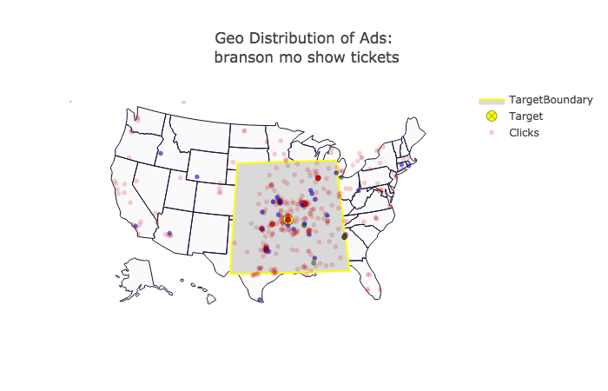
Ads 4061007624: branson mo show tickets
IB impressions rate: 0.752
CTR IB:0.077
GoodCTR IB:0.059
CTR OB: 0.081
GoodCTR OB: 0.081

Slide 13
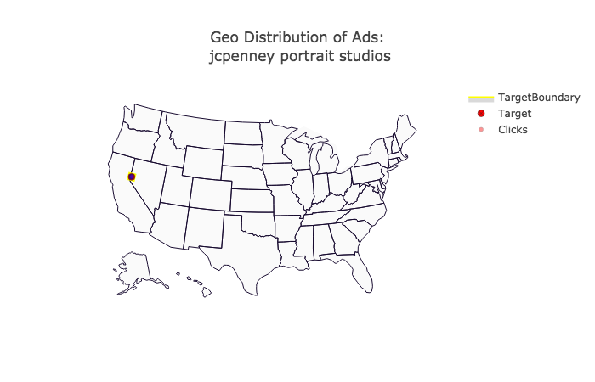
Ads 13788324073 : jcpenney portrait studios

Slide 14
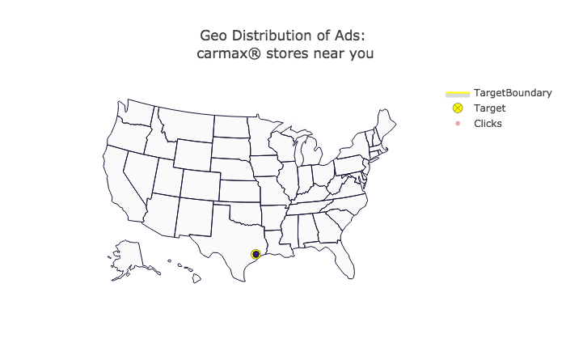
Ads 12229849372 : carmax® stores near you
IB impressions rate: 1.000
CTR IB:0.486
GoodCTR IB:0.434
CTR OB: 0.000
GoodCTR OB: 0.000

Slide 15
Ads 6684573884: denver mattress®
IB impressions rate: 0.934
CTR IB:0.084
GoodCTR IB:0.066
CTR OB: 0.273
GoodCTR OB: 0.273

Slide 16
Ads 10733724030: luxury pre owned duluth
IB impressions rate: 1.000
CTR IB:0.004
GoodCTR IB:0.004
CTR OB: 0.000
GoodCTR OB: 0.000

Slide 17
Ads 7783206080:certified used hyundai
IB impressions rate: 0.978
CTR IB:0.043
GoodCTR IB:0.025
CTR OB: 0.000
GoodCTR OB: 0.000

Slide 18
Ads 6786566351:sands casino bethlehem
IB impressions rate: 0.358
CTR IB:0.352
GoodCTR IB:0.318
CTR OB: 0.349
GoodCTR OB: 0.318

Slide 19
Ads 12229849367: carmax® official site
IB impressions rate: 1.000
CTR IB:0.528
GoodCTR IB:0.501
CTR OB: 0.000
GoodCTR OB: 0.000

Slide 20
Ads 4061007624: branson mo show tickets
IB impressions rate: 0.752
CTR IB:0.077
GoodCTR IB:0.059
CTR OB: 0.081
GoodCTR OB: 0.081

Slide 21
Ads 13788324073 : jcpenney portrait studios

Slide 22
Ads 12229849372 : carmax® stores near you
IB impressions rate: 1.000
CTR IB:0.486
GoodCTR IB:0.434
CTR OB: 0.000
GoodCTR OB: 0.000

Slide 23
Problems
Filter rule of Ads according to locations
Ads no target location
Ads with multiple target locations
How to combine location and semantic

